Slide 1
Update on 2016 AQ Modeling by EPA
September 24, 2018
US EPA/OAQPS/AQAD
Emission Inventory & Analysis Group
Air Quality Modeling Group

Slide 2
2016 AQ Modeling Platform Components
Components | 2016 v0 – complete | 2016 “alpha” – in progress | Notes
Model | CAMx v6.40 (cb6r4_CF) CMAQ v5.2 (cb6r3/AERO6) | CAMx v6.50 (cb6r4_CF) CMAQ v5.2.1 (cb6r3/AERO6) | Apply model version updates
Emissions | 2016 v0 (“fc”, scaled 2014 NEIv1) | 2016 alpha (“fe”, 2016 point sources, 2016 onroad, 2016 nonroad, CMV SO2 reductions, interpolated Canadian emissions to 2016; 2016 fires) | Plan to update to “2016 beta” and “2016 v1”
Meteorology | WRF v3.8 wrfcamx v4.6 MCIP v4.3 (“16j”) | WRF v3.8 wrfcamx v4.6 MCIP v4.3 (“16j”) | No change
IC/BC | 2016 GEOS-Chem v11-01; 36US3 CONUS (3-D) used for 12US2 | 2016 Hemispheric-CMAQv5.2.1; 36US3 CONUS (3-D) used for 12US2 | Decision to use 2016 GEOS-Chem or 2016 H-CMAQ run to provide IC/BC for 2016v1 model runs
Domains | 36US3 & 12US2 CONUS (shown on next slide) | 36US3 & 12US2 CONUS (shown on next slide) | No change
Layers | 35 vertical layers | 35 vertical layers | No change

Slide 3
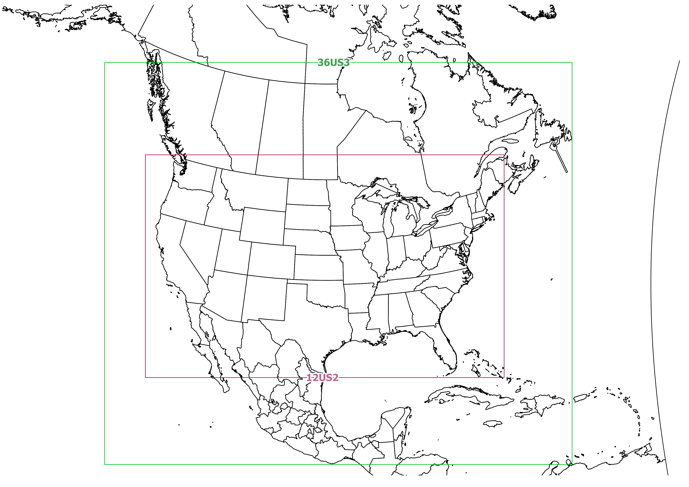
2016 Model Domains

Slide 4
2016 Operational Model Performance Plans (using EPA’s AMET tool; https://www.cmascenter.org/amet/)
Annual operational model performance evaluation to estimate the ability of the CMAQ and CAMx modeling systems to replicate the 2016 observed ambient concentrations.
Pollutants & Monitoring Networks:
Hourly & MDA8 Ozone, Sulfate, Nitrate, NO species, SO₂, VOC, Ammonium, Elemental Carbon, Organic Carbon; Wet Deposition of SO₄, NO₃, and NH₄
Clean Air Status and Trends Network (CASTNET); Interagency Monitoring of Protected Visual Environments (IMPROVE) network; Chemical Speciation Network (CSN); Air Quality System (AQS) network; National Atmospheric Deposition Program (NADP) network
Products:
Statistics by month/season and monitor Site ID & NOAA climate regions (shown on next slide)
Bias & Error spatial maps by season
Density Scatterplots by season & NOAA climate regions
Hourly & Monthly box and whisker plots: distribution of model to observational data by NOAA climate regions
Timeseries plots by season & monitor Site ID
Model performance for 2016 will be compared to model performance from previous platforms in 2011, 2014, and 2015. We also plan to compare model performance statistics for 2016 against the distribution of aggregate performance statistics from annual model runs from 2007 thru 2014.
We are reviewing the Final Model Performance Evaluation report from the Western Air Quality Modeling Study and we many expand our evaluation plans to include additional analytics based on that report.

Slide 5
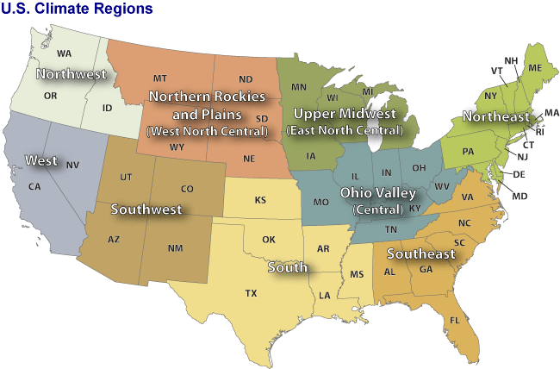
NOAA Climate Regions
(source: http://www.ncdc.noaa.gov/monitoring-references/maps/us-climate-regions.php#references)

Slide 6
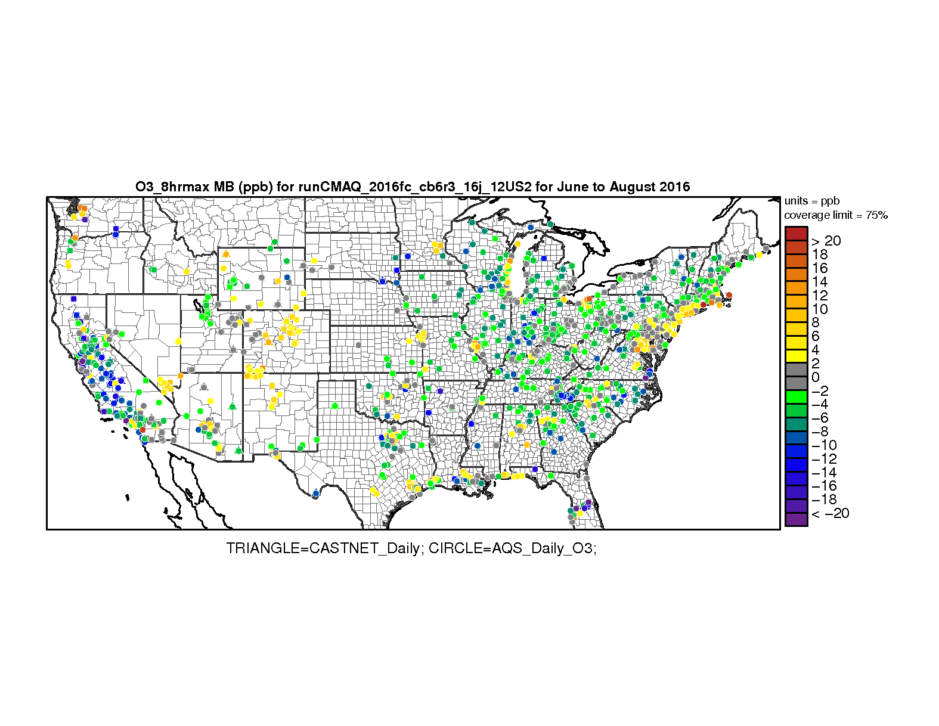
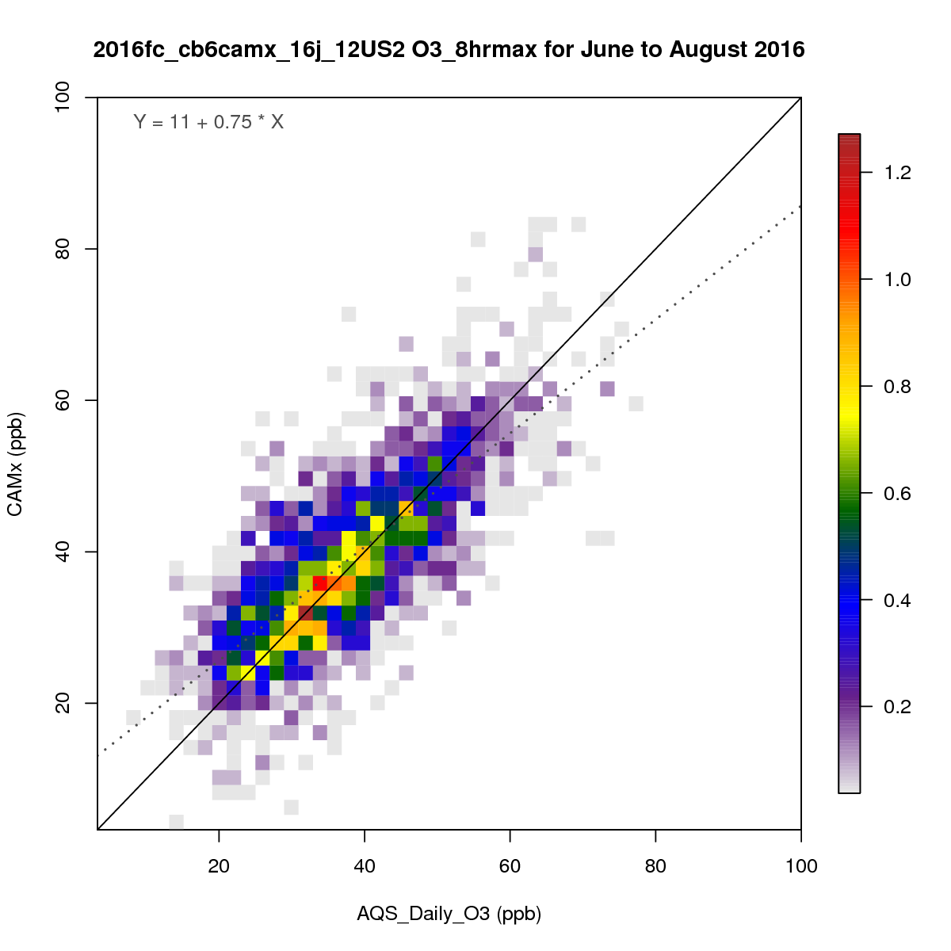
Examples of Operational Performance Plots
Bias & Error Spatial Maps
Density Scatterplots
NMB & NME (%); MB & ME (ppb/ugm⁻³)

Slide 7
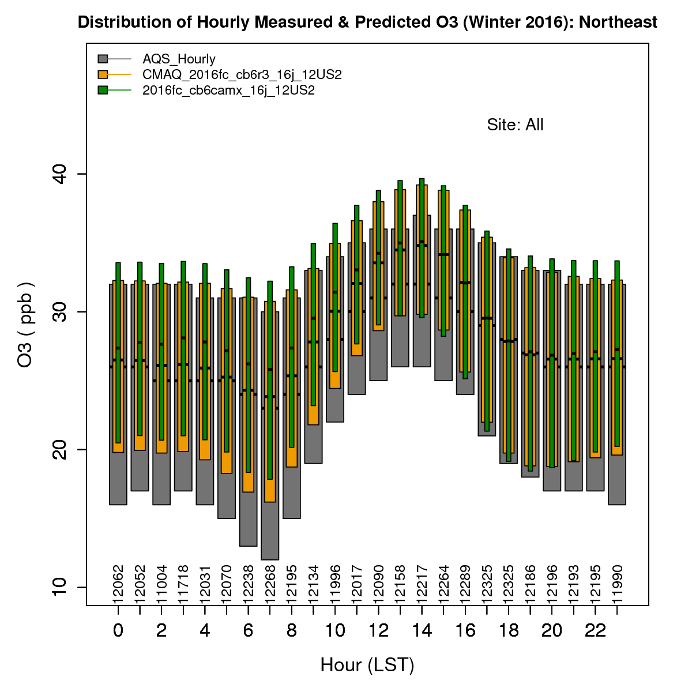
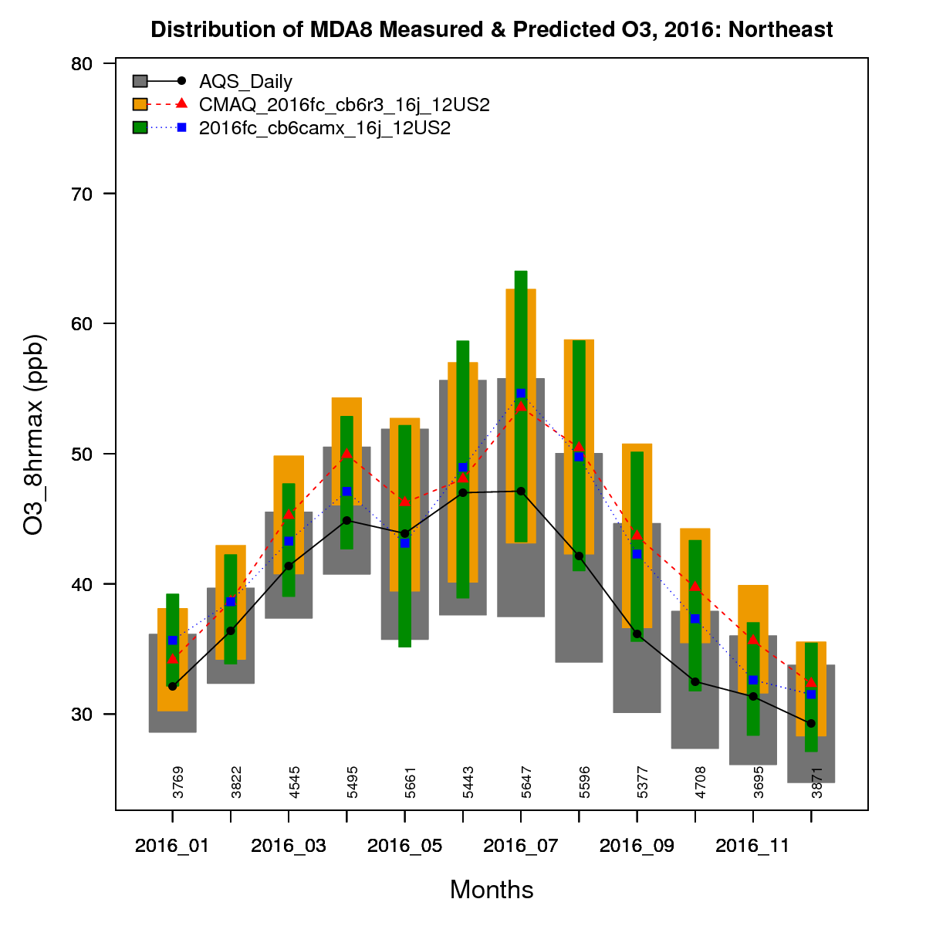
Examples of Operational Performance Plots
Hourly boxplots
Monthly boxplots

Slide 8
Next Steps
In-progress: modeling for 2016 using alpha inventory and 2016 H-CMAQ for 36-km BCs
Continue analysis and operational evaluation comparison of “2016 alpha” model runs with past air quality modeling platforms (2007 thru 2015)
Identify and investigate model performance issues from the 2016 alpha modeling
Construct 2016 4-km met for finer resolution air quality modeling for particular sub domains
Expect to start modeling with 2016 beta inventories by later this year

Slide 9
Topics for Further Discussion
Data Sharing
2016 model inputs and outputs
“site-compare” files that contain model predictions paired with the corresponding observations
Excel files with model performance statistics by site
Model performance analytics and findings
Plans by MJOs/states for evaluating the 2016 platform
Insights into aspects of the modeling that warrant further analysis to address any weaknesses identified from the model evaluation

